Slide 1

BaNKRUPTCY Prediction GROUP -2
Mr. Samit Dhawal
Meenakshi Nandipati
Mrs. Kanuri Geeta Manasa
Mrs. Sandesha Amit Shete
Ms. Samreentaj Y Sangam
Ms.ANANYA RAMPURA DHANANJAYA
Mr Prajwal Sangurmath

Slide 2
Business Objective:
This is a classification project, since the variable to predict is binary (bankruptcy or non-bankruptcy). The goal here is to model the probability that a business goes bankrupt from different features.
The data file contains 7 features about 250 companies
The data set includes the following variables:
industrial_risk: 0=low risk, 0.5=medium risk, 1=high risk.
management_risk: 0=low risk, 0.5=medium risk, 1=high risk.
financial flexibility: 0=low flexibility, 0.5=medium flexibility, 1=high flexibility.
credibility: 0=low credibility, 0.5=medium credibility, 1=high credibility.
competitiveness: 0=low competitiveness, 0.5=medium competitiveness, 1=high competitiveness.
operating_risk: 0=low risk, 0.5=medium risk, 1=high risk.
class: bankruptcy, non-bankruptcy (target variable).

Slide 3
Project Architecture/Project Flow
Project flow can be defined by the following steps
Exploratory Data Analysis
Data Visualization
Outlier Treatment
Feature Selection
Balancing the im-balanced data
Partition series
Model Building
Comparison of Performance
Deployment

Slide 4

Exploratory Data Analysis(EDA) and Visualizations

Slide 5
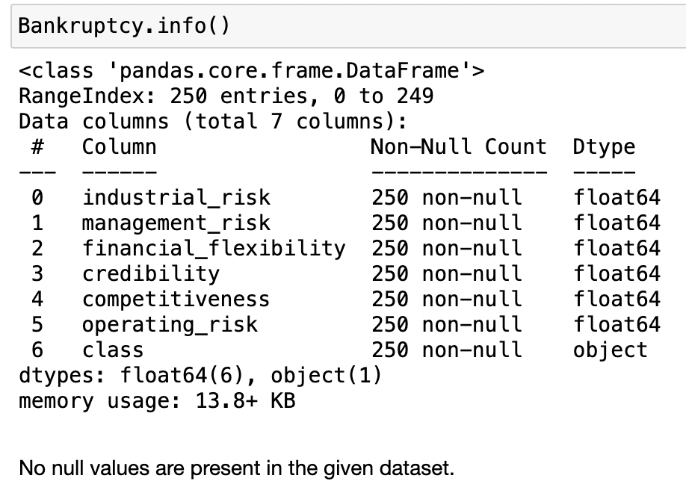

Slide 6
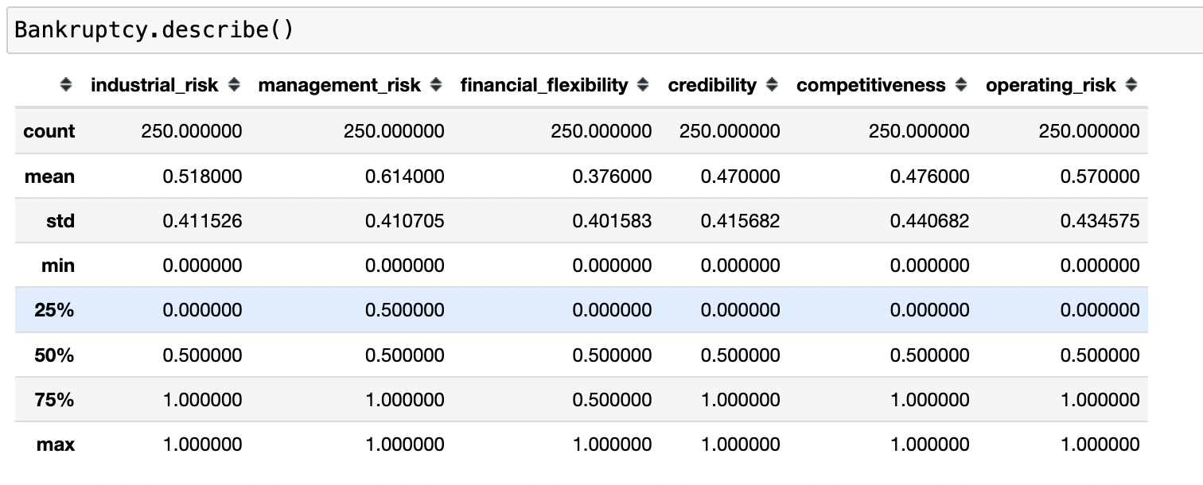

Slide 7
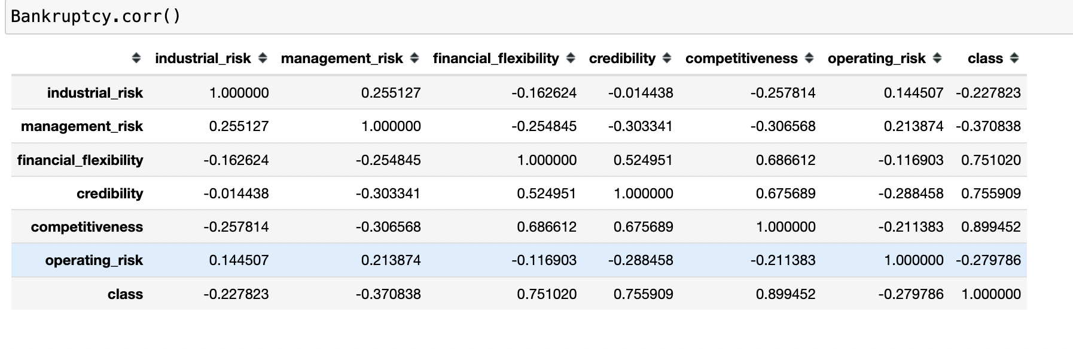

Slide 8
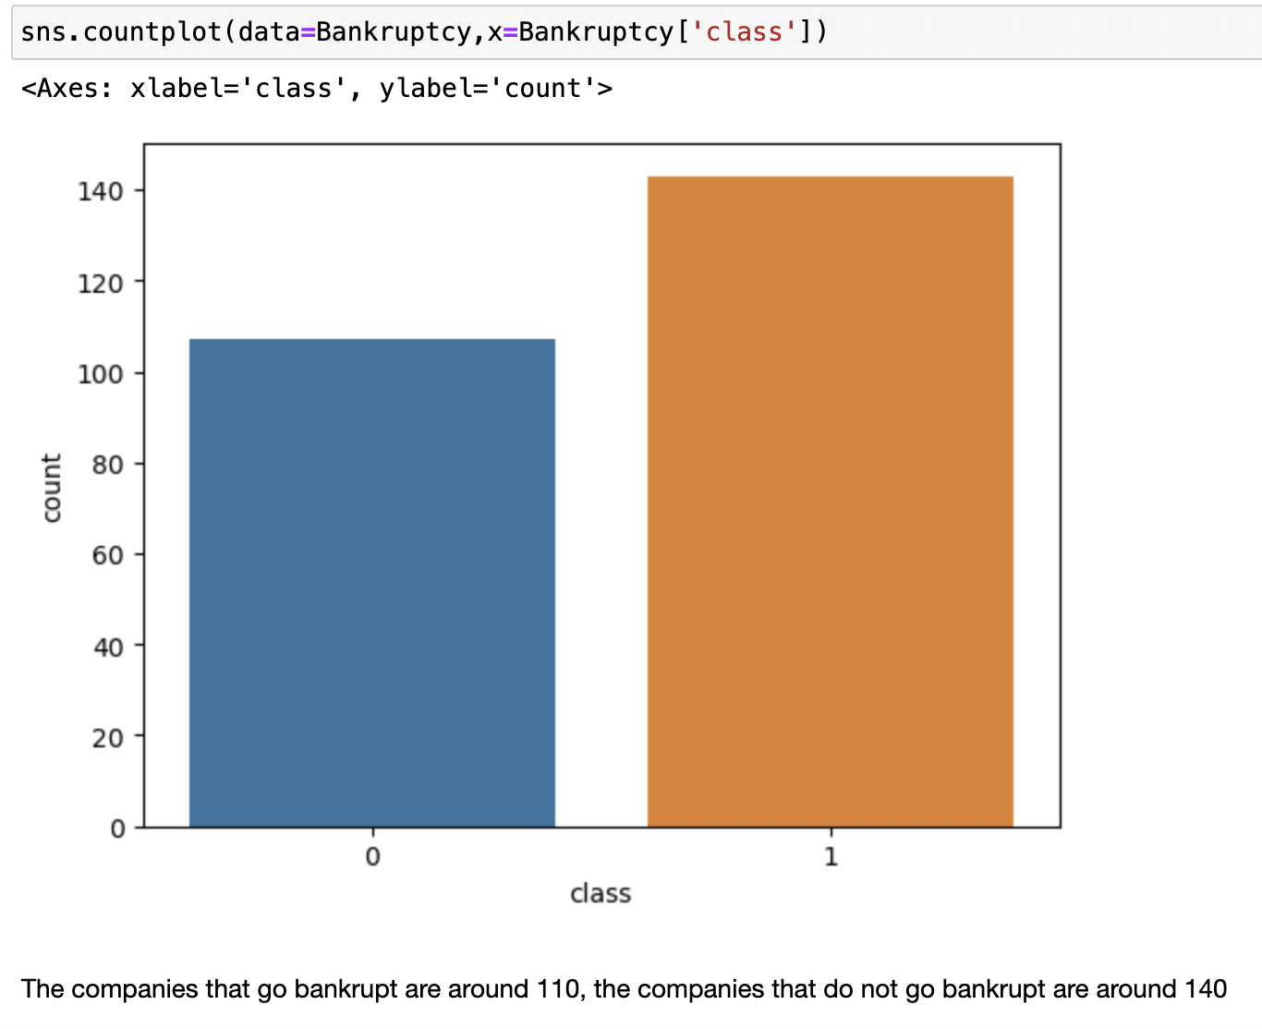

Slide 9
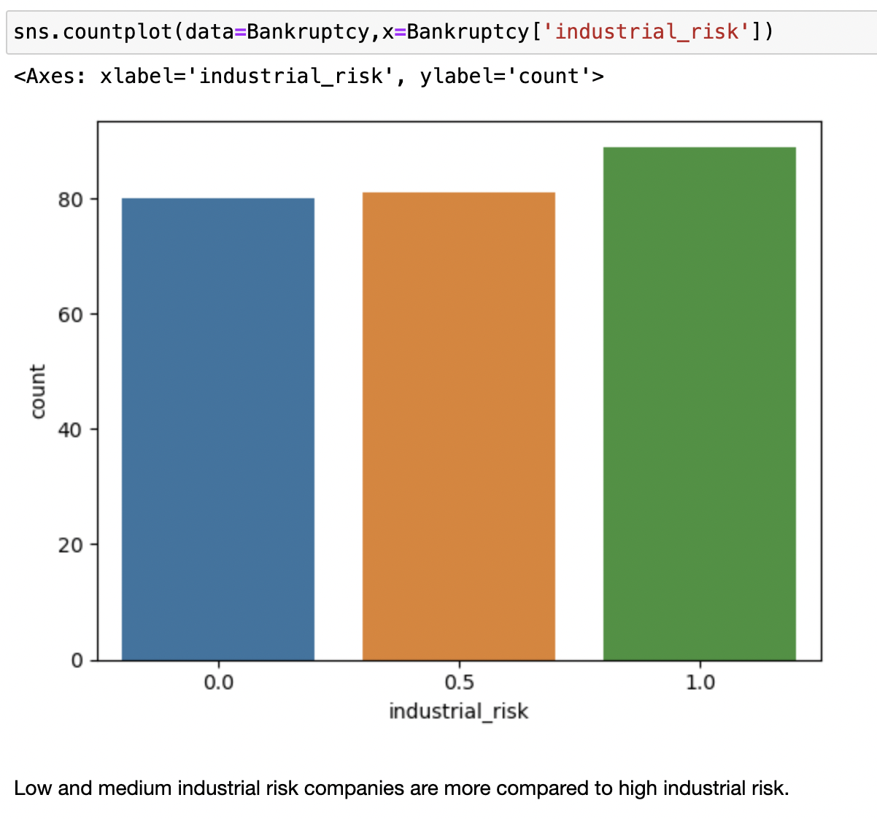

Slide 10
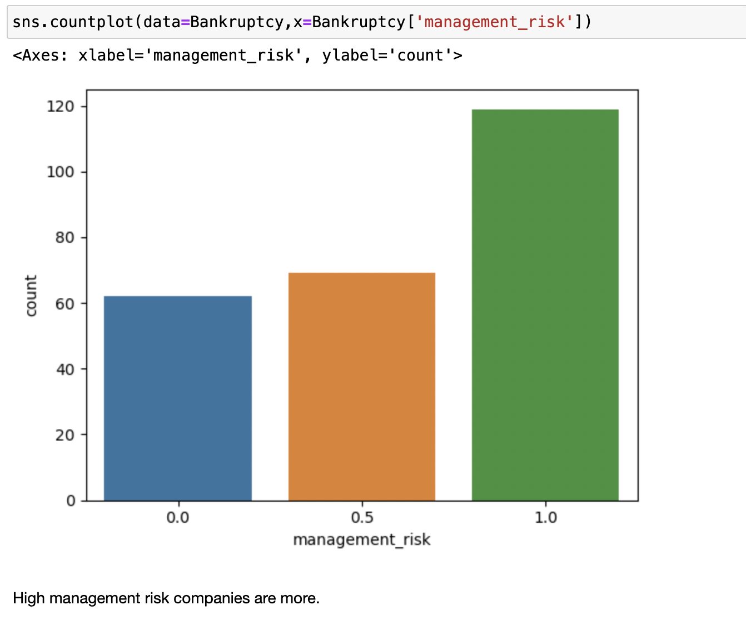

Slide 11
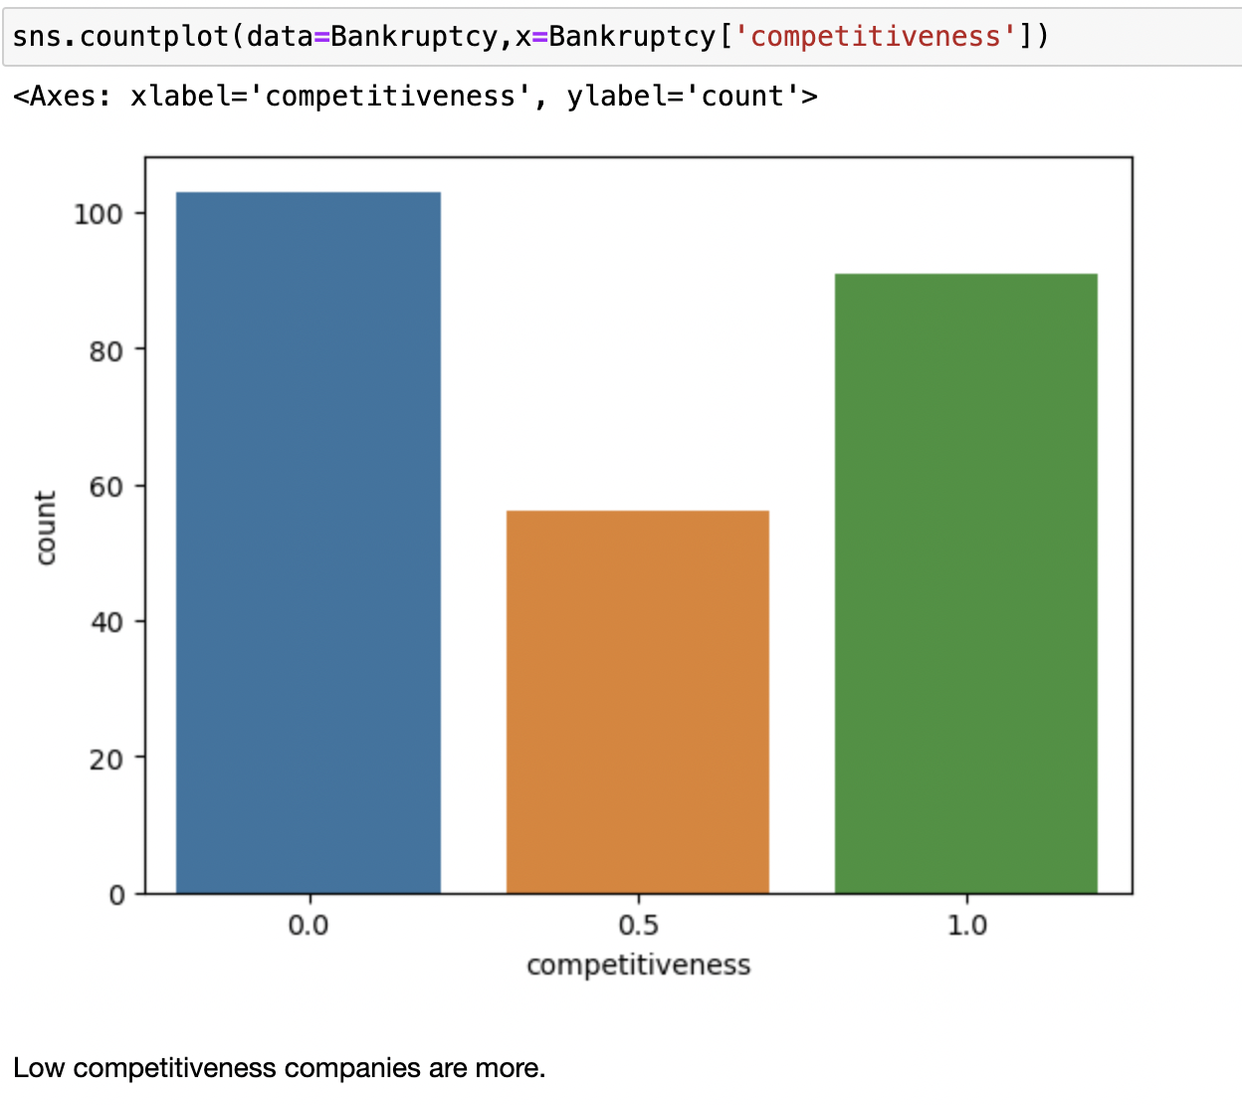

Slide 12
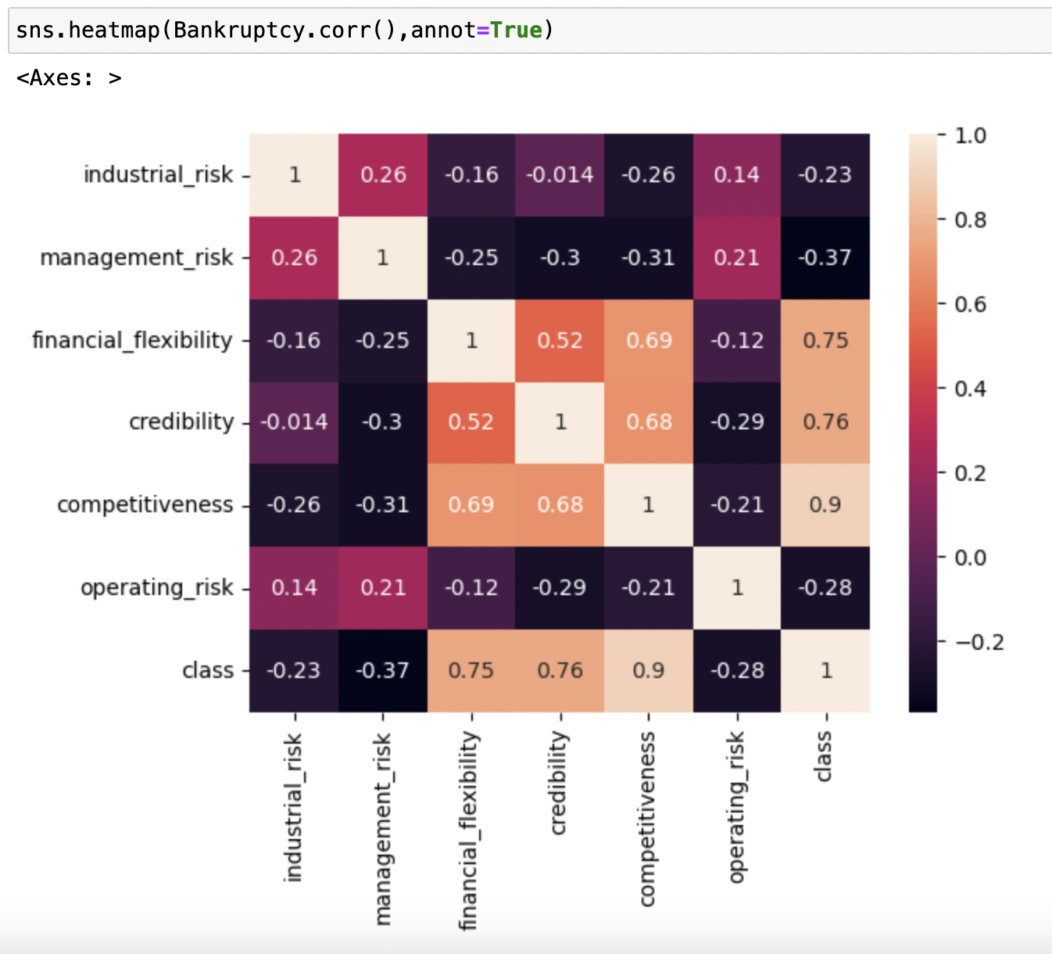

Slide 13
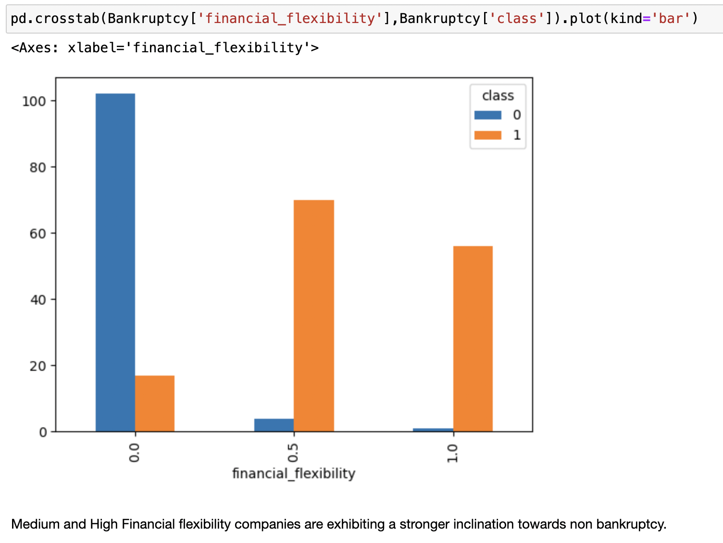

Slide 14
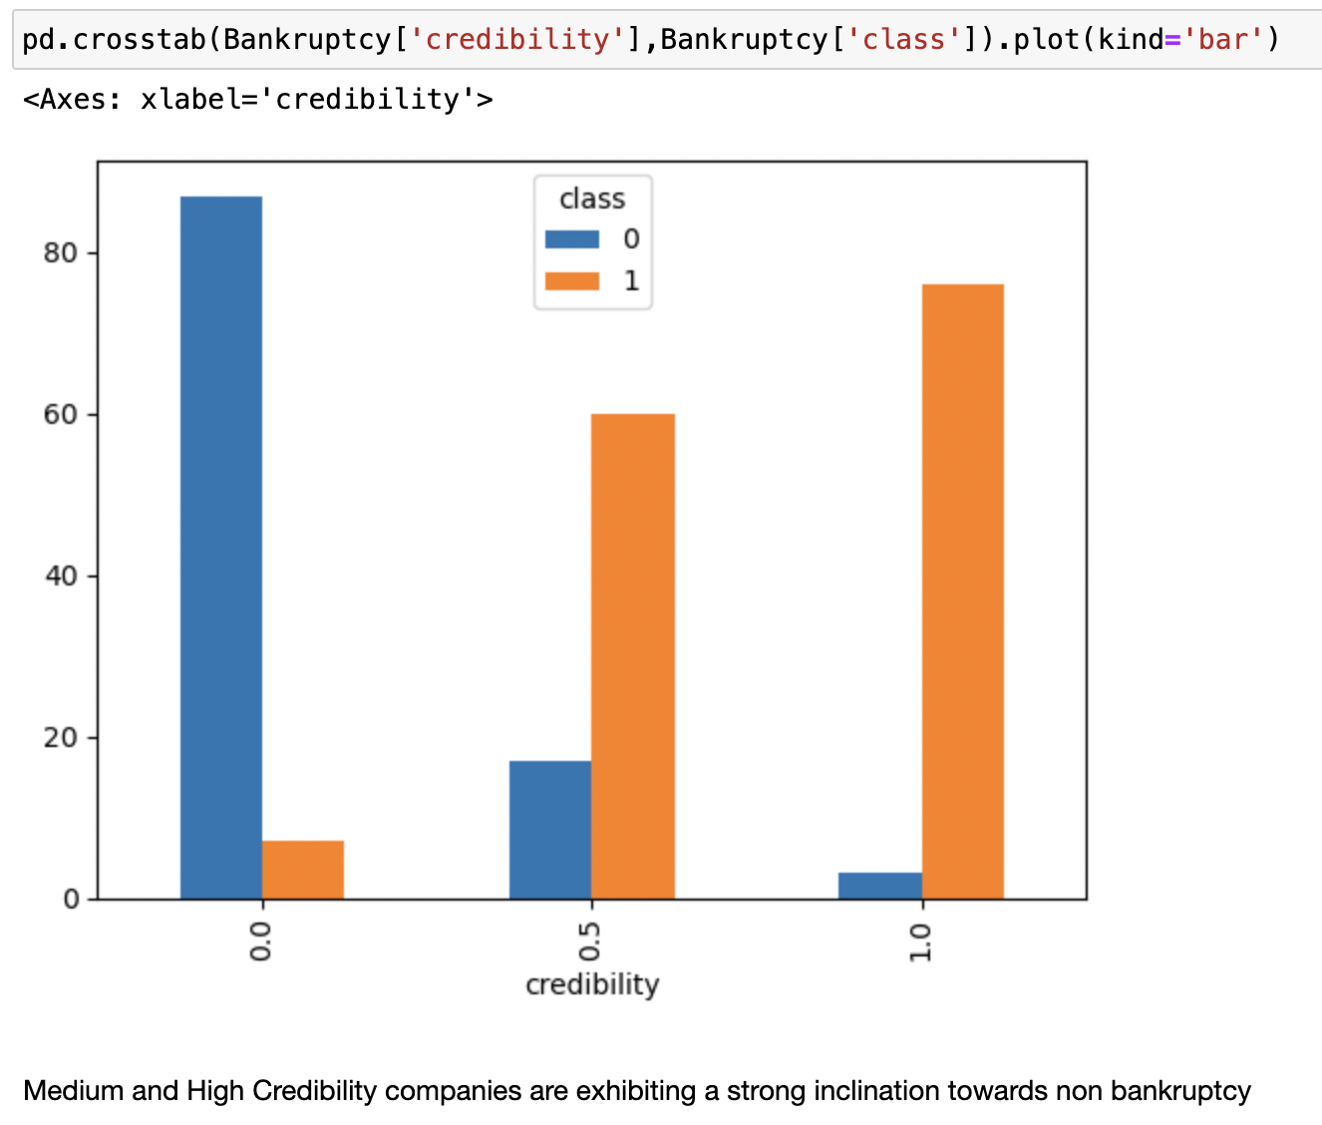

Slide 15
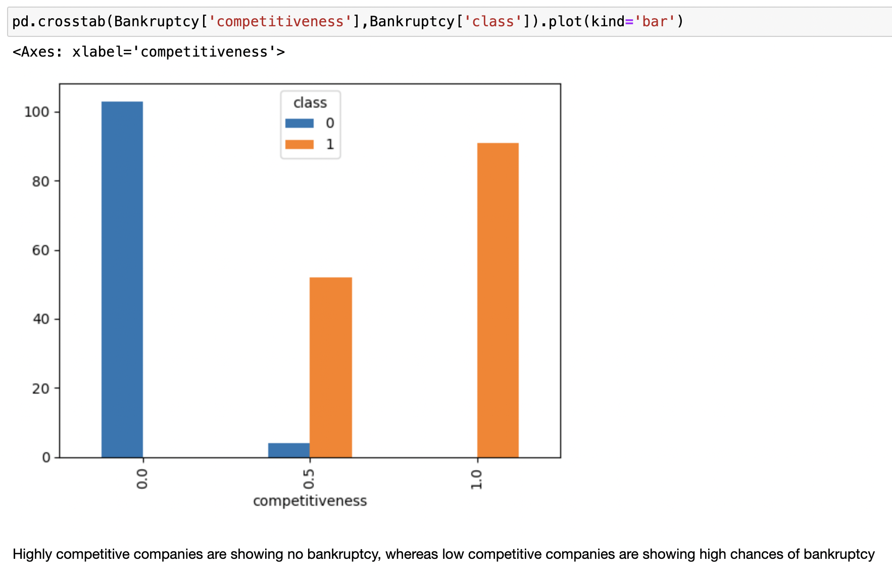

Slide 16

MODELLING AND EVALUATION

Slide 17
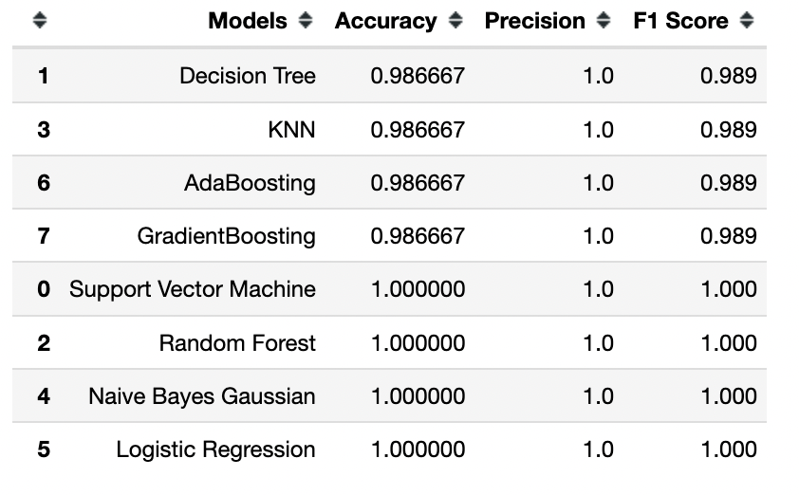

Slide 18

MODEL DEPLOYMENT

Slide 19
